Slide 1

Student Engagement and Churn Prediction
AI-Powered
Team Members:
Hammad Mengrani, Kareem Mamdouh, Laiba Jawaid, Priyanka Kute, Reeba Joshi, Rifat Islam, Sumaya Mateen
8th September, 2025

Slide 2
Agenda
Introduction & Business Problem
Dataset Overview
Data Preprocessing
Exploratory Data Analysis (EDA)
Churn Analysis
Model Building
Model Comparison
Summary of Strategic Value
Churn Factors & Recommendations
Limitations & Future Work
Conclusion

Slide 3

Introduction & problem Statement
Strong Initial Enthusiasm
  Students enroll with high motivation to gain skills and career growth.
  Start with strong expectations, ambition, and promise of opportunities.
Unexpected Dropouts
  31.8% of students withdraw silently without warning signals.
  No clear indicators → difficult to predict or intervene.
  Dropouts driven by multiple factors (personal, academic, platform-related).
  Leads to loss of potential and wasted platform resources.
Core Problem
  High enrollments, but low course completions.
  Urgent need for predictive solutions to detect risks early and reduce churn.

Slide 4
Dataset Overview
Total Records
8558
Total Countries
70
Success Rate
47.6%
Peak Signups
946
  Scale: 8,558 learner applications
  Coverage: 70 countries, grouped into 5 regions, 23 programs
  Success Rate: 47.6% overall with significant demographic variations
  Key Insight: Peak activity was in August 2023 with 946 signups

Slide 5
Data Preprocessing
Data Cleaning:
Convert Data Types
Standardize Text
Map Inconsistent Values
Check Duplicates
Opportunity Start Date → Mode (grouped)
Institution & Major → Group Imputation
First Name → "Not Specified"
Missing Values Imputations

Slide 6
Data Preprocessing
Feature Engineering:
Temporal Features:
Demographic Features:
Behavioral Features:
Composite Features:
Capture time-based patterns
Classify Learners by background
Reflect learner activity & success
Combine multiple attributes
Like: Quick_Applicant, Signup_to_Apply_Days
Like: Age_Group, Region
Like: Engagement_Score, Opportunity_Popularity
Like: Age_Major_Combo, Country_Gender

Slide 7


Exploratory Data Analysis
Data Quality
Descriptive Analysis
Visualization & Insights
Validate Structure
Numerical stats
Plot trends & correlation
Handle missing & duplicate
Categorical distributions
Extract key insights

Slide 8
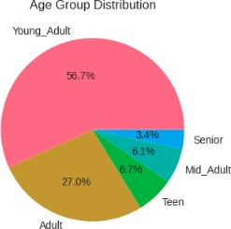
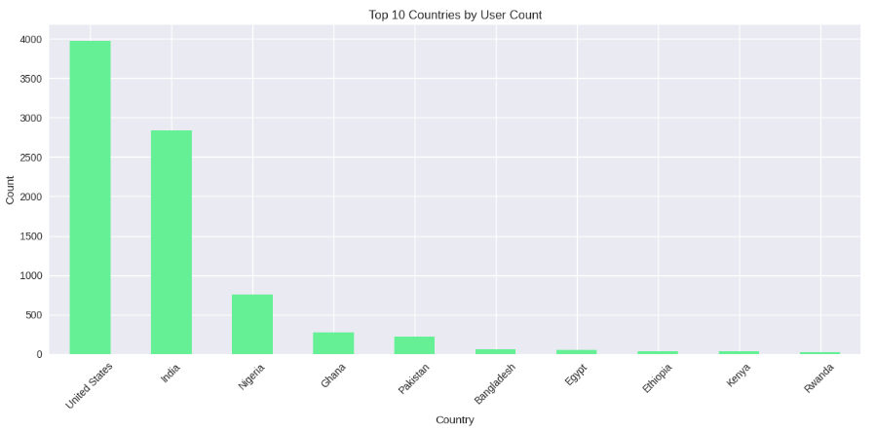
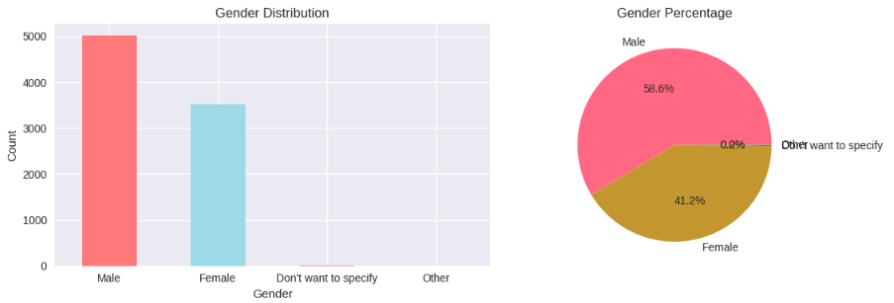
Demographic Insights
Insight:
Young Adults dominate (56.7%); Teens and Seniors are underserved (<10%), offering key growth potential.
Insight:
Enrollment is heavily concentrated in the United States and India, indicating strong market presence.
Insight:
The majority of users are male, making up over half of the total user base.

Slide 9
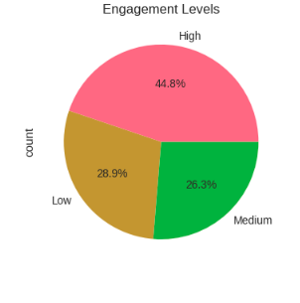
Engagement Distribution
Engagement Metrics:
Average Engagement Score: 0.47
Engagement Level Distribution:
  High: 3,835 (44.8%)
  Low: 2,472 (28.9%)
  Medium: 2,251 (26.3%)
Insights:
Retained learners have significantly higher engagement scores.
Churned users apply more, but have a lower success rate.

Slide 10
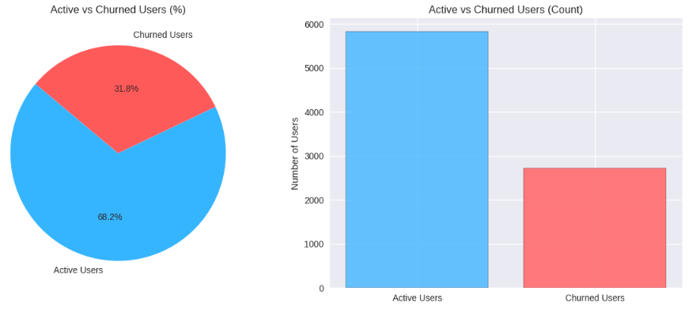
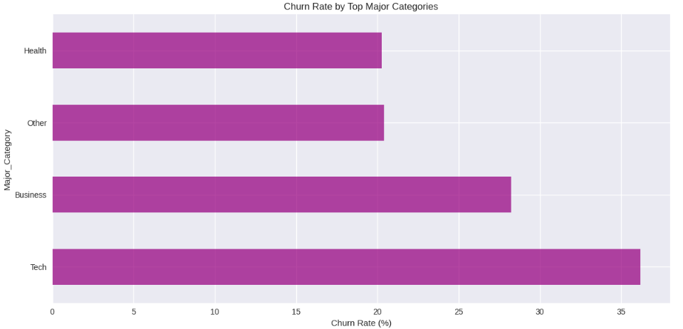
Churn Analysis
    Understanding & Defining Churn:
    Challenge: Multiple churn definitions (status codes, behaviors, demographics)
    Approach: Rule-based clustering with Kmeans
    Key Features for Thresholds:
        Engagement_Score
        Applications_per_User
        User_Success_Rate
        Apply_vs_Start_Gap
    Churn Rules:
        Low/no engagement
        Many unsuccessful attempts
        Dropped before course start
        Very low success despite many applications
Insight:
Nearly one-third (31.8%) of users have churned, indicating a significant challenge with user retention that requires immediate attention.

Slide 11
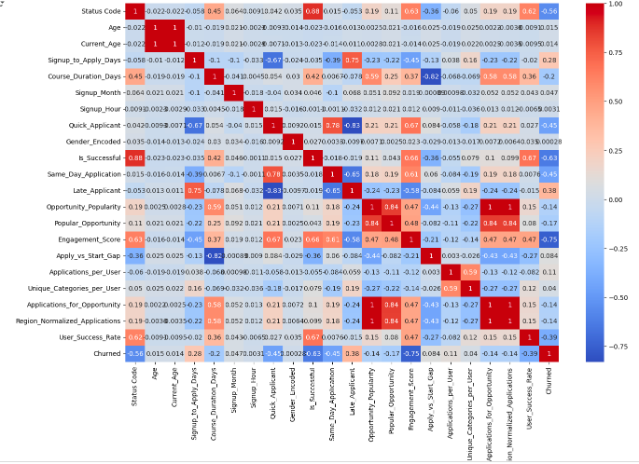
Model Building for Churn Prediction
  Feature Selection to Avoid Leakage:
    Correlation analysis for churn-related features
    Removed status-based features (status_code, status_description)
    Checking Circular dependency
    Retained features providing predictive value without leakage
  Models Tested: Logistic Regression, SVM, Random Forest, Gradient Boosting, XGBoost
  Final Model: Gradient Boosting Classifier and gives 91% accuracy, 0.86 F1-score

Slide 12
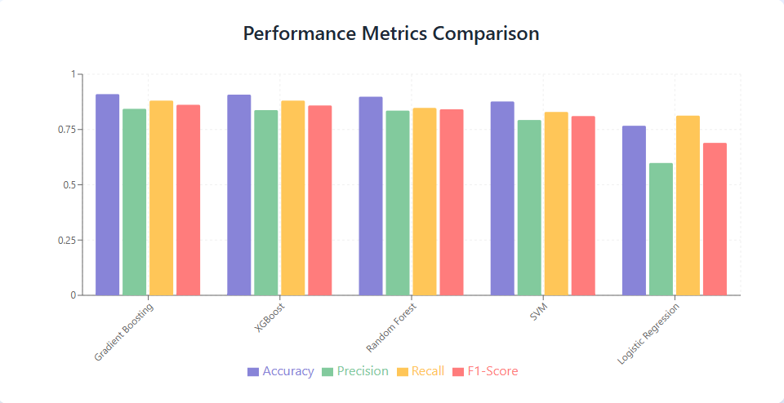
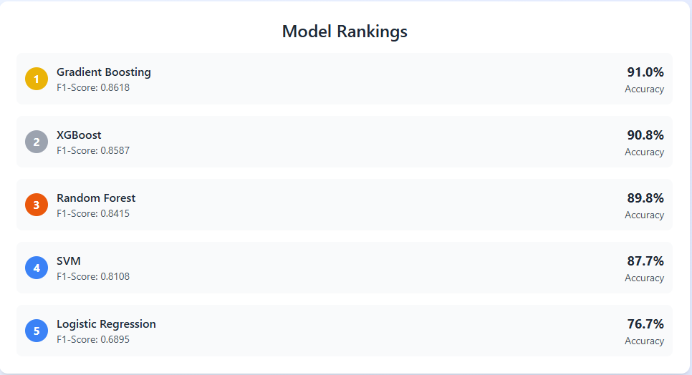
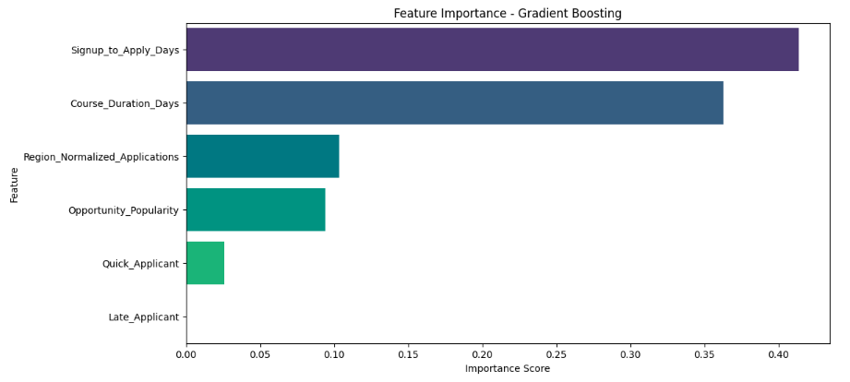
Model Comparison
2
3
Churn Factors

Slide 13
Churn Factors & Recommendations
Delayed First Application = Early Dropout Risk
Strategy: Automate a multi-email onboarding sequence with a video tour and personalized opportunity suggestions to drive immediate action.
Long Course Duration = Higher Overwhelm & Churn
Strategy: Restructure long courses into weekly modules, each with a micro-certificate, to prevent learner overwhelm.
Low Regional Application Rate = Localized Disengagement
Strategy: Develop region-specific content and community hubs to increase local relevance and engagement.
Chasing Popular Opportunities = Mismatch-Driven Churn
Strategy: Enhance the recommendation algorithm with collaborative filtering to surface trending and peer-approved opportunities.
Instant Applications = Rushed Decisions, Higher Regret
Strategy: Improve early onboarding to ensure users understand the platform before applying.
Late Applications = Indecision Signals, Likely Churn
Strategy: Use AI-driven prompts to re-engage users who show signs of indecision early in their journey.

Slide 14

Limitations & Future Plans
  Current Gaps: Missing socioeconomic data, Motivation factors, European representation
  Future Plans:
    Deep learning models
    Real-time analytics
    A/B testing
    Social network analysis
  Identified Core Problem: Mostly churn rate driven by application delays, course length, and engagement gaps.
  Built Predictive Solution: Gradient Boosting model achieves 91% accuracy in forecasting student churn.
  Delivered Actionable Strategies: Personalized interventions, adaptive content, and targeted campaigns to boost retention.
  Enabled Proactive Approach: Shift from reactive support to data-driven, preemptive student success initiatives.

Slide 15
Thank You!

